Slide 1
In association with the
26 Field Regiment RCA
XII MB Dragoons Museum
A Salty Dog Production

Slide 2
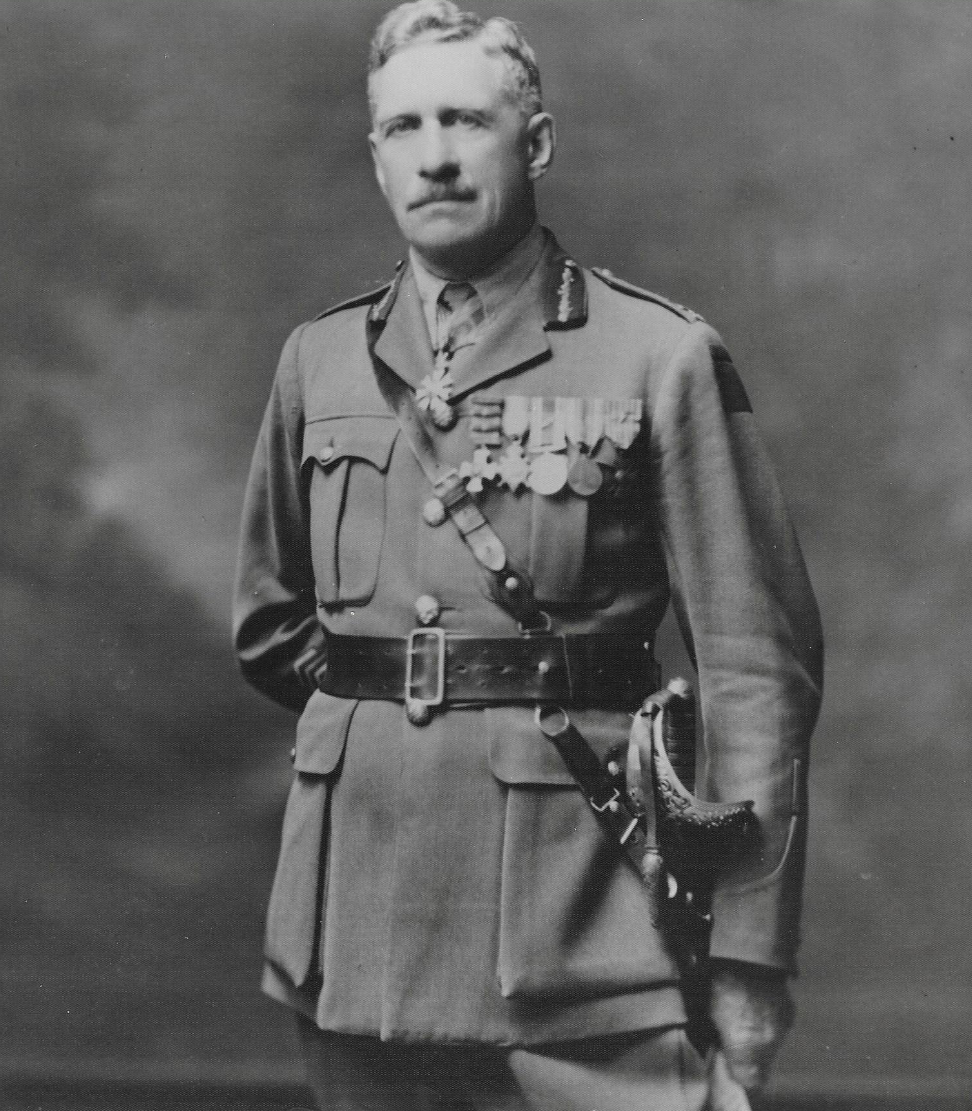
Brigadier General James Kirkcaldy, CMG, DSO

Slide 3
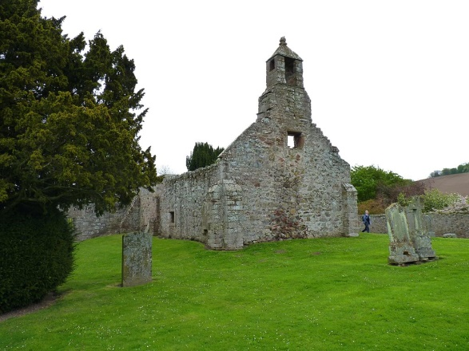
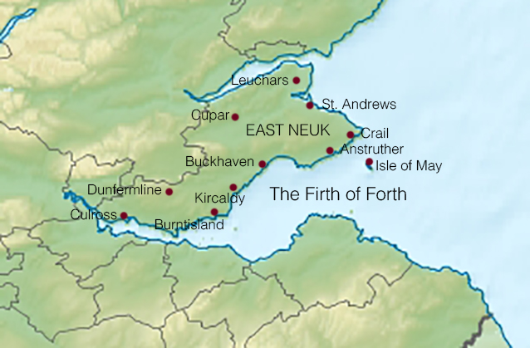
James Kirkcaldy (1866-1957) Soldier, Police Chief, Businessman and Civil Servant
Born at Abdie, Scotland on 18th May 1866, Abdie is a parish in north-west Fife, lying on the south shore of the Firth of Tay. Population approx. 400. Son of James Kirkcaldy and Helen Brand. The Family name comes from the Scottish word for church “Kirk” and “Culdees” a early Christian sect in Ireland, Scotland and England. In the middle ages.
The ruins of the old
Abdie parish church The Firth of Tay

Slide 4
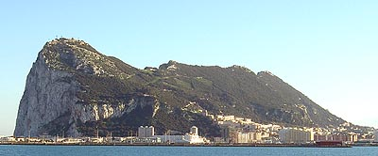
Other notable people from Abdie
Lt Colonel Ninian Imrie of Denmuir Fellow of the Royal Society of Edinburgh (FRSE). He was a Scottish army officer and geologist. He gave the first wholly geological description of the Rock of Gibraltar.

Slide 5
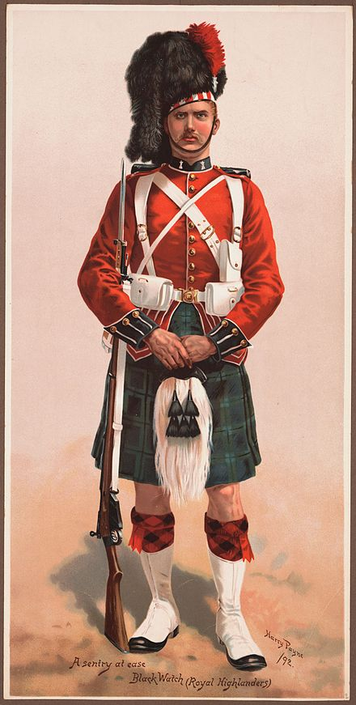
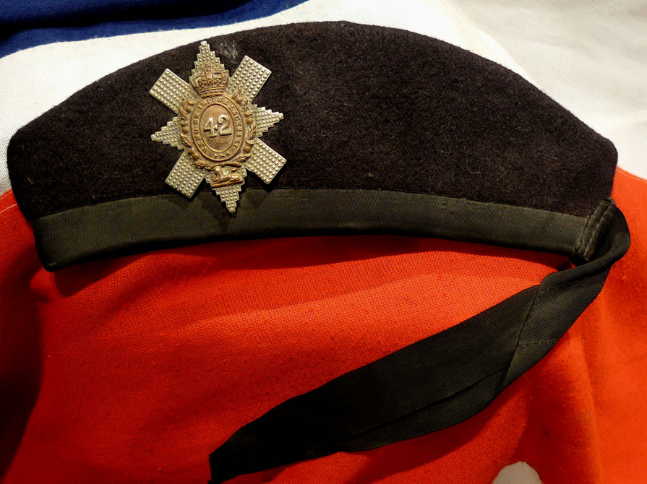
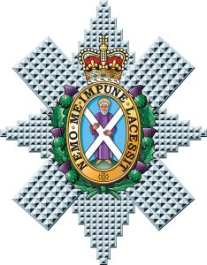
Member of the Black Watch for 7 years

Slide 6
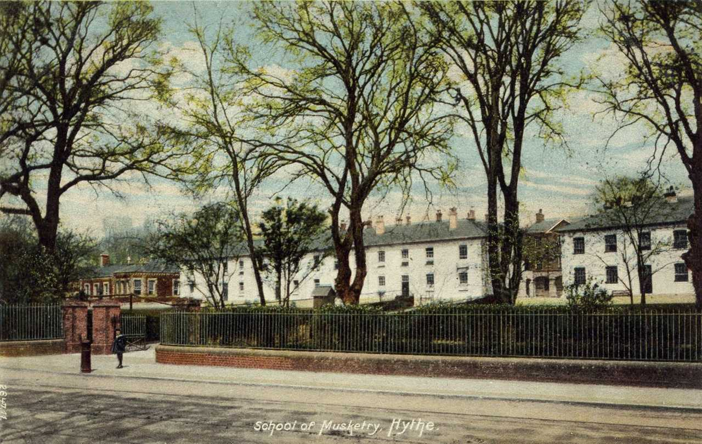
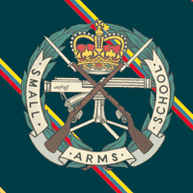
Staff Instructor at the Hythe School of Musketry in Kent England.

Slide 7
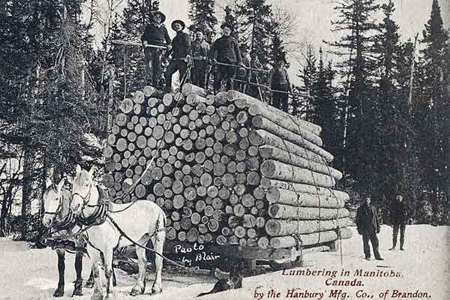
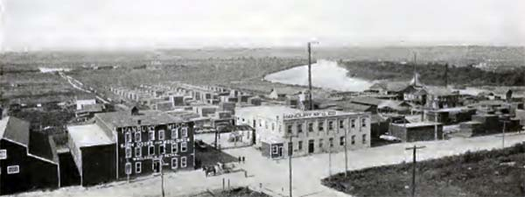
A new world of challenges
In 1891, he married Rosina Hannah Perry, Daughter of Joseph Perry of Hythe England. Her birth date was in 1866, and she died on 19th December 1961 aged 95 years.
They had seven children, Kathleen Rose, James Douglas, Archibald J, John A, Helen, Minnie H, and Fred
In 1891 he arrived in Brandon, and worked for Mr. John Hanbury’s sawmill for $1.50 a day.

Slide 8
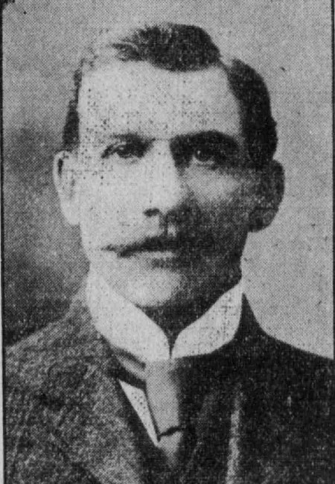
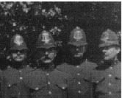
Brandon Police Service
The following year he was appointed Chief of Police, the fourth Chief Constable, of the City. Succeeding J. R. Foster, a position that Kirkcaldy held for thirteen years.

Slide 9
In 1905 he resigned as Chief Constable to operate the Empire Hotel in partnership with James Smith. The hotel was opened by Mr. D. Beaubier in June of 1904 after delays in construction. He took on Smith and Kirkcaldy as partners. The building took extensive damage in 1910 when a fire tore through the top floor which collapsed the roof. The 1916 prohibition laws hit Brandon hotels hard. To increase revenue, the Empire Hotel began to rent the ground floor of their building to the F. W. Woolworth Co. The Woolworth Co. purchased the building in February, 1929. It was knocked down in 1957 to allow the company to build a more modern department store. The store was eventually converted to ACC’s Adult Collegiate.

Slide 10
Empire Hotel 725 Rosser Avenue

Slide 11
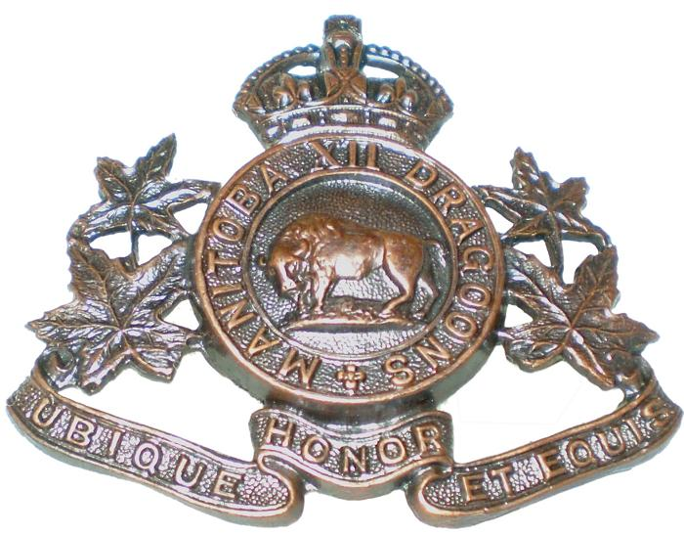
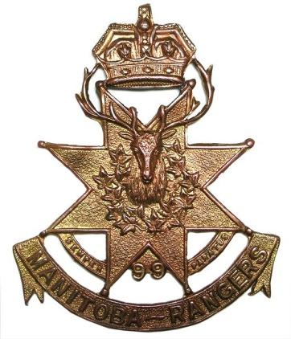
XII MB Dragoons and 99th Manitoba Rangers
He was a member of the Canadian Militia (XII Manitoba Dragoons) from 1907 to 1910 and Major of the 99th Manitoba Rangers in 1914.

Slide 12
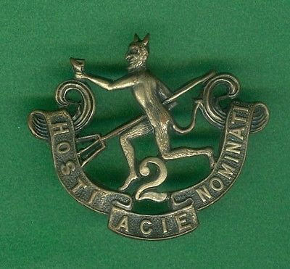
8th BN CEF (90th Winnipeg Rifles)
He joined the Canadian Expeditionary Force in August 1914 serving as a Major in the 8th Battalion CEF of the 90th Winnipeg Rifles. He was wounded at the second Battle of Ypres and was invalided to Canada.

Slide 13
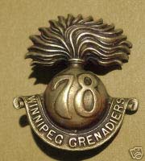
78th BN (Winnipeg Grenadiers)
He then raised the 78th Battalion of the Winnipeg Grenadiers and took it to France in 1916, serving at The Somme, Vimy Ridge, Passchendaele, Arras, Amiens, and Cambria. On the death of Brigadier General McBrien, he was given Brigade Command, serving at Canal du Nord, Valenciennes, and Mons.

Slide 14
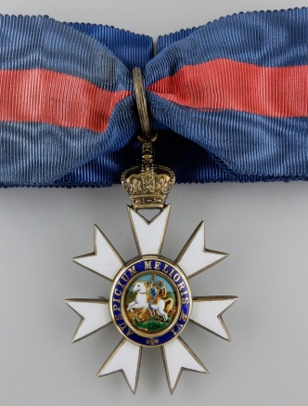
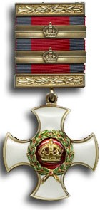
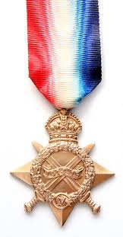
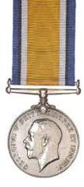
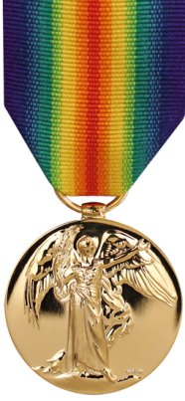
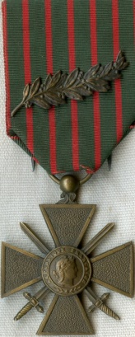
Brigadier General Kirkcaldy was awarded, The Companion of the Order of Saint Michael and Saint George, The Distinguished Service Order 03/02/17; first bar 06/07/18; second bar 18/01/19; 194-1915 Star, the War medal the Inter Alied victory medal and The French Croix de Guerre. He returned to Canada in June 1919.

Slide 15
The Citation
Lieutenant Colonel James Kirkcaldy, D.S.O. 78th (Winnipeg Grenadiers) Battalion
For conspicuous gallantry and resourceful leadership. When one of his companies was held up by machine-gun fire, he took charge and overcame the opposition. Later, by aggressive fighting, he got his battalion forward, and formed a defensive flank, using a rifle himself and directing machine–gun and trench-mortar fire, and drove the enemy from their positions. His courage and fighting spirit were an inspiration to all.
(Kirkcaldy D.S.O. Citation, London Gazette, July 1918, 133)

Slide 16
City Assessor and Alderman
In October 1923, he was appointed as Brandon City Assessor. He served as an Alderman on the Brandon City Council from 1934 to 1952, serving continuously except for one year.

Slide 17
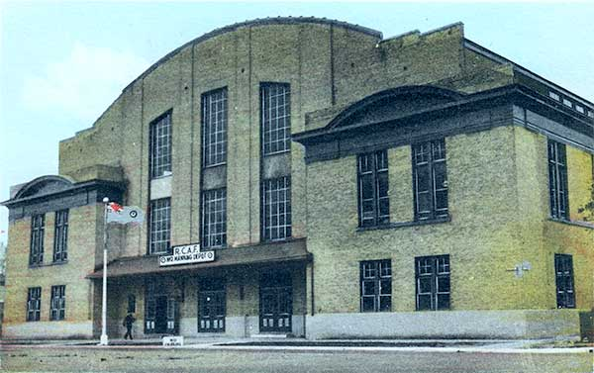
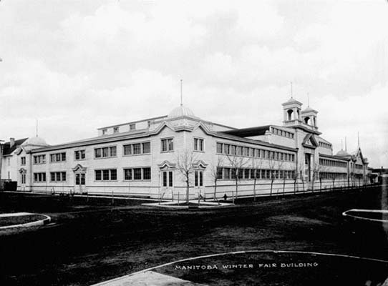
He was President of the Brandon Winter Fair and the Brandon Livestock Assoc.
Wheat City Arena home of the Winter Fair after The Winter Fair Building burnt down
Royal Canadian Mounted Police (RCMP) horses were housed in the Winter Fair Building which was located on the 600 Block of 10th street, south of the new BPS station. On 29th October 1920, a fire that started in the RCMP horse barns destroyed the Winter Fair Building.

Slide 18
Manager of the Brandon Branch of the Government Liquor Control Commission
In 1923, the local Liquor Commission Store was selected to open on Seventh Street, and Pacific Avenue. In the former premises occupied by the Dominion Hardware & Lumber Company. The Manager was James Kirkcaldy who received the first shipment of Spirits and opened for business on 17th October.

Slide 19
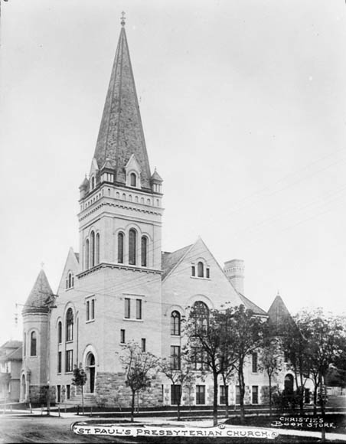
He was a member of the Brandon Lodge #19, the Masonic Order and the Presbyterian Church.

Slide 20
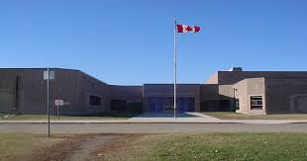
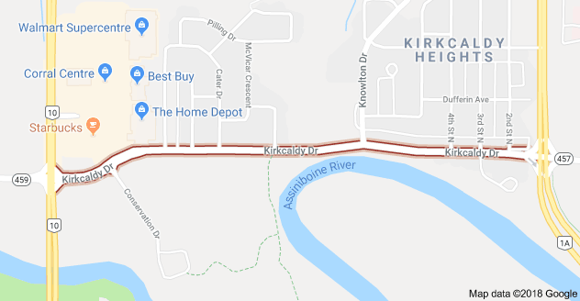
Brigadier General Kirkcaldy died at Brandon on 8th May 1957 and was buried in the Brandon Cemetery. He is commemorated by Kirkcaldy Drive and Kirkcaldy Heights School in Brandon.
The End

Slide 21
Thank you,

